Slide 1

UNDERSTANDING QUADRILATERAL
WORKSHEET ON MODULE-2/4
Q.1. Name the polygon in which the sum of the interior angles equals the sum of the exterior angles.
Q.2. Find the number of sides of a regular polygon whose each exterior angle is 45$°$.
Q.3. A quadrilateral has three acute angles each measuring 85$°$. Find the measure of fourth angle

Slide 2
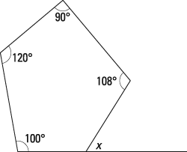
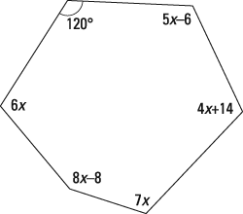
Q.4.Find the value of x in the fig given.
(i) (ii) (iii)

Slide 3

Q.5. Find the sum of the exterior angles of a
(i) decagon (ii)an octagon (iii)12-gon (iv) n-gon
Q.6.One exterior angle of a regular polygon is 20$°$. How many sides does it have?
Q.7. The exterior angles of a heptagon are y,2y,3y,3y,4y,5y and 6y. Find the value of y.
Q.8Find ‘x’ in the given fig.

Slide 4

Q.9. Find the measure of (a) each interior angle (b) each exterior angle of a regular polygon of 24 sides.
Q.10. Find ‘x’ if the exterior angles of a hexagon are(2x-2)$°$, (6x+4 )$°$ (4x+1)$°$, (7x-2)$°$,(8x+3)$°$ and( 3x-5)$°$.
Q.11. If each interior angle of a regular polygon is 150$°$, how many sides does this polygon have?

Slide 5

Q.12. The ratio between the exterior angle and the interior angles of a regular polygon is 2:7.
Find the no. of sides of the polygon.
Q.13. If each interior angle of a regular polygon is 144$°$, how many sides does this polygon have?
Q.14. The ratio between the exterior angle and the interior angles of a regular polygon is 2:7. Find the no. of sides of the polygon.

Slide 6

Q.15. Is it possible to have a regular polygon with measure of each exterior angle as 22$°$?
Q.16. What is the minimum interior angle possible for a regular polygon? Why?
Q.17. What is the maximum exterior angle possible for a regular polygon?

Slide 7
PRACTICE MAKES A PERSON PERFECT.
THANK YOU

